Slide 1
Apache Axis
Lecturer: Ngo Huy Bien
Software Engineering Department
Faculty of Information Technology
VNUHCM - University of Science
Ho Chi Minh City, Vietnam
nhbien@fit.hcmus.edu.vn

Slide 2

Objectives

Slide 3

Contents

Slide 4

References
Ramarao Kanneganti and Prasad Chodavarapu (2008). SOA Security. Manning Publications Co.

Slide 5
Apache Axis
https://axis.apache.org/
The well known Apache Axis, and the the second generation of it, the Apache Axis2, are two Web Service containers that helps users to create, deploy, and run Web Services.
Axis2 is avaialble in both Java as well as C.

Slide 6
1. Install Tools [1]
Java SE Development Kit
http://www.oracle.com/technetwork/java/javase/downloads/index.html
Apache Tomcat
http://tomcat.apache.org/
Apache Axis
http://ws.apache.org/axis/
Web Services Invocation Framework
http://ws.apache.org/wsif/
http://www.fiddler2.com/fiddler2/

Slide 7
2. Creating a Web Service
Defining the service interface
Converting the interface to WSDL: The Ant script available in the examples archive provides a java2wsdl target.
Implementing the service: Axis provides a WSDL2Java tool to assist in implementing the service and testing it.
Deploying the service: Run the command ant deploy. The Ant script packages the classes needed as a jar file that is then copied to the webapps/axis/WEB-INF/lib/ folder of Tomcat.
public interface Brokerage extends java.rmi.Remote {
public float getQuote(String symbol)
throws java.rmi.RemoteException;
}

Slide 8
3. Invoke Service using Pre-generated Stubs
In this mechanism, the client application developers have access to WSDL.
Tools such as WSDL2Java generate a class that implements all the service interface methods to simply forward each method call to the real service implementation using SOAP RPC.
Such generated classes are known as client stubs.
float quote = stub.getQuote();

Slide 9
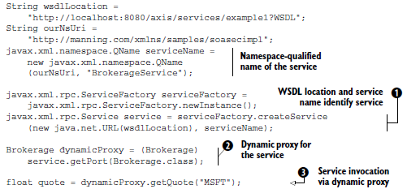
4. Invoke Service using Dynamic Proxy
The client application developers have only access to the server-side interface when developing.
WSDL is only available at runtime.
The toolkits need to generate at runtime an object that implements a given service interface.
The generated object should of course forward each method call to the real service implementation using SOAP RPC.

Slide 10
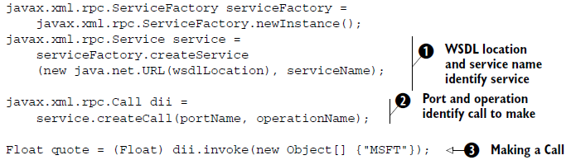
5. Invoke Service using Dynamic Invocation Interface
An application does not know the interface or WSDL at design time.
A Call object can be used to fill in the in and in/out parameters and retrieve the out and in/out parameters after invocation.

Slide 11

Thank You & See You Again

